Slide 1
San Francisco Police Department Data Science Interview Project
Justin Irving
2/1/2024

Slide 2
Problem Statement
San Francisco Fire Department (SFFD) must inspect R-2’s annually.
Housing Inspection Services (HIS) must conduct routine inspections of R-2’s at least once every five years.
Question: how should SFFD and DBI organize their R-2 inspections to prioritize highest risk buildings?

Slide 3
Initial Considerations for Analysis
What are some factors that define a “risky” building?
Buildings that received a violation (SFFD or HIS) during a routine or or complaint investigation.
Buildings that received certain types of violations associated with hazardous conditions.
Buildings where a fire incident occurred.
Reasons for prioritization?
Is it difficult to complete all inspections with given resources?
Do risky buildings need to be addressed as quickly as possible?
Both?

Slide 4
Approach
Deep dive into data
Extract data using API.
Understand structure/data clean-up/joins.
Perform basic feature engineering (in some cases).
Join Assessor Data with Incident and Inspection Data and look for building characteristics that may be linked to increased likelihood of event (violation or incident).
Join on parcel requiring intermediate spatial join with parcel data in some cases.
Check for significant data features that predict incidents and/or violations.
Cross-reference violations from HIS and SFFD to see if this helps understand likelihood of violation in respective department.
Provide recommendations based on data understanding and analysis.

Slide 5
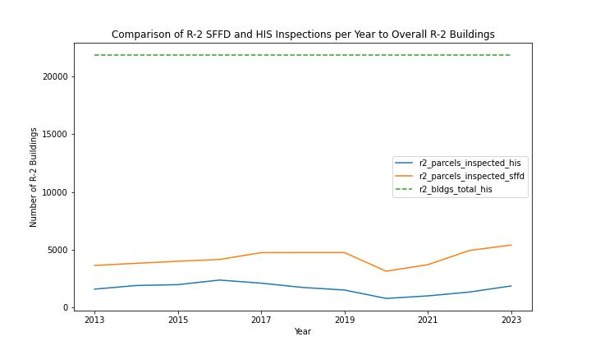
Drivers For Prioritization
An R-2 flag could not be found in the Assessor Data so one was created based on problem statement criteria (this could lead to over estimation of total R-2)
Assuming parcel R-2 designations are correct:
SFFD is at about 20% of goal
HIS is at about 40% of goal
Based on SFFD inspection data with type “R2 Company Inspection” SFFD frequency is closer to annual (average once per 1.2 yrs)
Unclear if this encompasses all R-2 parcels without better R-2 definition
If SFFD isn’t meeting inspection goals and HIS has more capacity, we should consider ways to make sure priority buildings get inspected by one of the agencies on an annual basis.

Slide 6
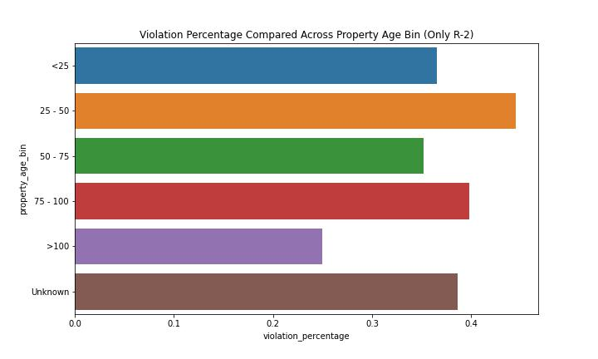
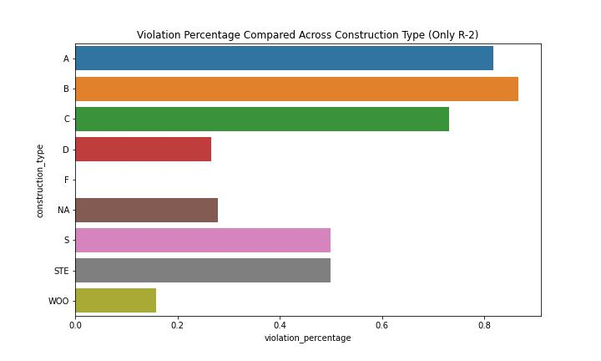
Factors that Relate to SFFD Violations
Checked violation rate across different factors from assessor data
Violation rate is on a per parcel basis (if parcel ever has had a violation it is a 1, if not it’s a 0). Divide parcels with violation by all parcels in group.
Filtered data to look at R-2 only (using SFFD inspection flags)
Property age appears to have some relationship with violation rate but not strong
Construction type seems to have a fairly strong relationship (Why? Need more understanding)

Slide 7
Factors that Relate to HIS Violations
Checked violation rate across different factors from assessor data
Violation rate is on a per parcel basis (if parcel ever has had a violation it is a 1, if not it’s a 0). Divide parcels with violation by all parcels in group.
Filtered data to look at R-2 only (using SFFD inspection flags)
Property age appears to have some relationship with violation rate but not strong
Construction type seems to have a fairly strong relationship (Why? Need more understanding)

Slide 8
General Recommendation Ideas
HIS complaints division is likely busy and cannot take on additional work. Responding to complaints is important for tenant safety, etc.
HIS violations and complaints related to fire and electrical at R-2 parcels that might overlap with SFFD concerns should be flagged and routed to the SFFD database to help prioritize investigations.
This could be more easily done with additional breakdown of the text field for complaints and investigations in the HIS data (NLP can help here but modifications to input forms should be considered).

Slide 9
Recommendations to Improve Data Sources
SFFD
Standardize primary situation in fire incident data
DBI
Provide addition select boxes for complain types on complaint form (appears to be mainly text).
Use NLP to pull out keywords from text fields.
Communicate active fire-related complaints. associated with R-2 to SFFD for prioritization.
Perform additional NLP on violations text to enrich data on violation concern.
Standardize action_taken_primary field in fire incident data

